Slide 1
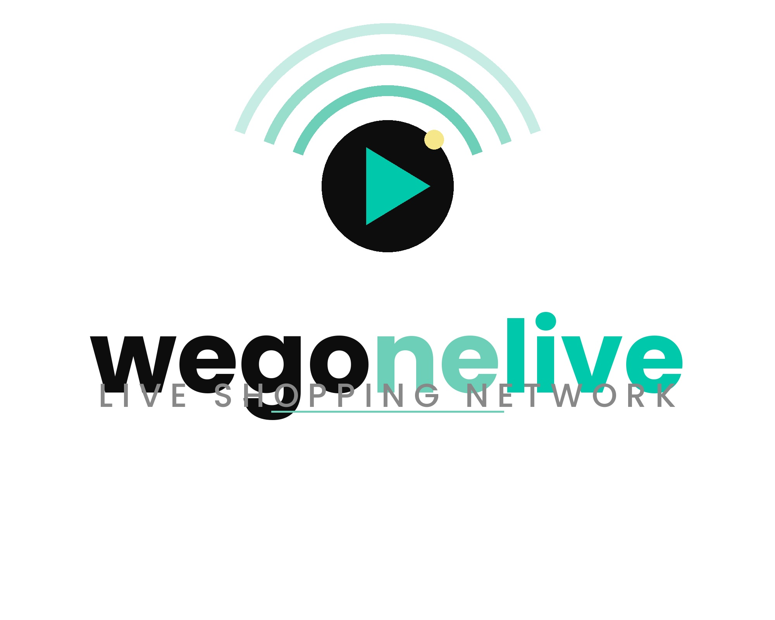
Live Commerce Architecture
Client-safe overview · Designed for confidence without exposing proprietary mechanics
Operationally strong: real-time event controls + fallback decision paths
Governed by clear policy modules and auditable event records
Built for repeatable execution across live sessions

Slide 2
What Clients Receive
Business value, not internal secret sauce
Reliable live session orchestration
Pricing guardrails and fallback handling
Role-based operational dashboard
Post-event traceability and performance reporting

Slide 3
System Layers
Execution Plane
Intelligence & Governance
• Presentation layer (public + operator views)
• Real-time bidding and event control services
• Decision orchestration modules
• Valuation integration adapters
• Metrics and analytics pipeline
• Identity, access, and audit trail

Slide 4
Runtime Flow
1) Session configured with inventory and valuation references
2) Live event executes with controlled bid intake
3) Policy evaluation at close selects outcome path
4) Checkout or fallback offer orchestration
5) Metrics + notices written for post-run review

Slide 5
Control Model
Operator Controls
Risk Controls
• Session activation
• Item/row targeting
• Guided fallback actions
• Single-pane monitoring
• Policy thresholds
• Soft/hard validation options
• Restricted internal insights
• Event-level traceability

Slide 6
Architecture Gems
Policy-first orchestration keeps outcomes consistent under pressure
Fallback path protects value when primary close conditions are not met
Row-level targeting keeps live execution aligned with inventory state
Audit-friendly notices and metrics reduce post-event ambiguity

Slide 7
Security & Compliance Posture
Least-privilege access for internal operational surfaces
Secrets and privileged keys remain server-side
Separation of public experience and restricted controls
Traceable decisions for governance and replay

Slide 8
Scalability & Reliability
Modular architecture supports phased expansion
Near real-time visibility for operators during event execution
Graceful fallback behavior if optional integrations are unavailable
Deployment strategy can align with client cloud standards

Slide 9
Engagement Model
Phase 1: Discovery + policy mapping
Phase 2: Pilot with measured success criteria
Phase 3: Controlled rollout with operator enablement
NDA deep-dive available for implementation specifics

Slide 10
Closing
This architecture is built to execute live commerce with discipline.
It combines operational clarity, policy guardrails, and measurable outcomes.
Next step: align pilot scope to your event model and governance requirements.

